Slide 1
Social Network Analysis
Markets and Strategic Interaction in Networks
Prof. Keeheon Lee
TA. Jaekeun Lee
010-5599-9411
agdal1125@gmail.com

Slide 2
Table of Contents
- Matching Markets
- Network Models of Markets with Intermediaries

Slide 3
Matching Markets

Slide 4
Bipartite Graphs and Perfect Matchings
  Assigning rooms to students in accordance to their preferences
Room1
Viki
Room1
Viki
Room2
Wendy
Room2
Wendy
  Perfect matching is an assignment of nodes so that (1) each node is connected by an edge to the node it is assigned to and (2) no two nodes on the left are assigned to the same node on right
Room3
Xin
Room3
Xin
Room4
Yoram
Room4
Yoram
Room5
Zoe
Room5
Zoe
Bipartite Graphs
Perfect Matching

Slide 5
Bipartite Graphs and Perfect Matchings
  Matching Theorem
Room1
Viki
N(S)
S
  If a bipartite graph has no perfect matching, then it must contain a constricted set
Room2
Wendy
  Constricted Set
  A set is constricted if it has more nodes than that if its neighbor nodes;
  S > N(S)
  ex) S = 3, N(S) = 2
Room3
Xin
Room4
Yoram
Room5
Zoe
Constricted Set

Slide 6
Valuations and Optimal Assignments
  Valuation
  Rather than putting the case into a binary assignment, valuation allow each individual to express how much they want it
  Quality
  Evaluation of the assignment by summing up individual’s valuations
valuations
valuations
Room1
Xin
12 , 2 , 4
Room1
Xin
12 , 2 , 4
Room2
Yoram
8 , 7 , 6
Room2
Yoram
8 , 7 , 6
Room3
Zoe
7, 5 , 2
Room3
Zoe
7, 5 , 2
A set of valuations
Optimal Assignment; quality = 12+ 6 + 5 = 23

Slide 7
Valuations and Optimal Assignments
  Bipartite Matching Problem
  Of course, the bipartite matching problem can be solved with valuation and optimal assignments
valuations
Room1
Viki
Room1
Viki
1 , 1 , 1
Room2
Wendy
Room2
Wendy
1 , 0 , 0
Room3
Xin
Room3
Xin
0 , 1 , 0

Slide 8
Prices and Market-Clearing Property
  Valuation – price = payoff → buyers will prefer the highest payoff
  Market clearing:
  cause each buyer to buy from a different seller
Sellers
Buyers
valuations
Prices
Sellers
Buyers
valuations
A
X
12 , 4 , 2
5
A
X
12 , 4 , 2
  Existence of Market Clearing Prices:
  For any set of buyer valuations, there exists a set of market clearing prices
B
Y
8 , 7 , 6
2
B
Y
8 , 7 , 6
C
Z
7 , 5 , 2
0
C
Z
7 , 5 , 2
  Optimality of Market Clearing Prices:
  For any set of market clearing prices, a perfect matching in the resulting preferred seller graph has the maximum total valuation of any assignment of seller to buyers and produces the maximum possible sum of payoffs to all sellers and buyers
Prices
Sellers
Buyers
valuations
Prices
Sellers
Buyers
valuations
2
A
X
12 , 4 , 2
3
A
X
12 , 4 , 2
1
B
Y
8 , 7 , 6
1
B
Y
8 , 7 , 6
0
C
Z
7 , 5 , 2
0
C
Z
7 , 5 , 2

Slide 9
Network Models of Markets with Intermediaries

Slide 10
Price Setting in Markets
  Matching markets embody a number of basic principles:
  - People naturally have different preferences for different objects or goods
  - Prices can decentralize the allocation of goods to people
  - Such prices can lead allocations that are socially optimal

Slide 11
Trade with intermediaries
  - In a wide range of markets, buyers and sellers do not interact directly with each other, but trade through brokers or intermediaries
  ex) Real estate brokers, drug dealers
  - There are many types of markets for different purpose or characteristics
  - Particular good can be traded in multiple markets

Slide 12
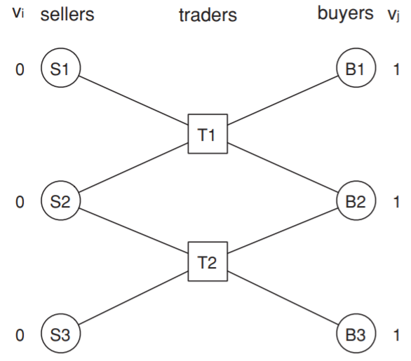
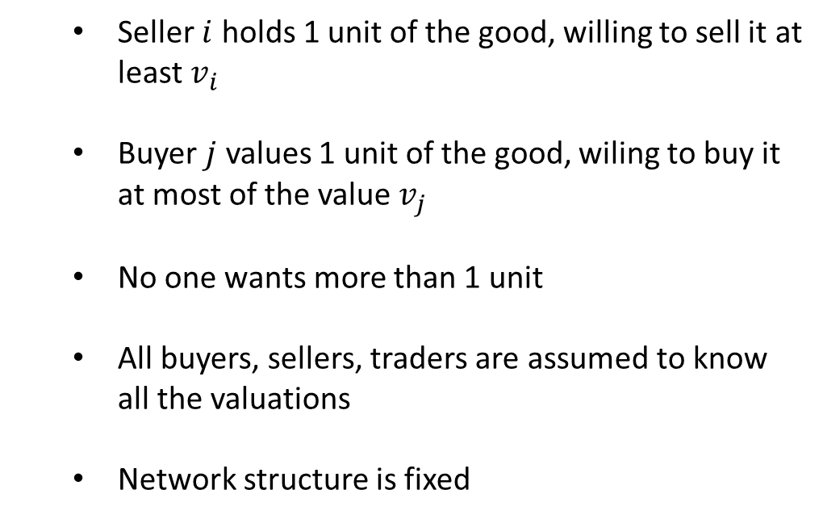
Network structure with multiple traders: simple model
  With multiple buyers, sellers, and intermediaries connected in a network structure, what might be the trading behavior at the equilibrium??
  Seller $i$ holds 1 unit of the good, willing to sell it at least $v_{i}$
  Buyer $j$ values 1 unit of the good, wiling to buy it at most of the value $v_{j}$
  No one wants more than 1 unit
  All buyers, sellers, traders are assumed to know all the valuations
  Network structure is fixed

Slide 13
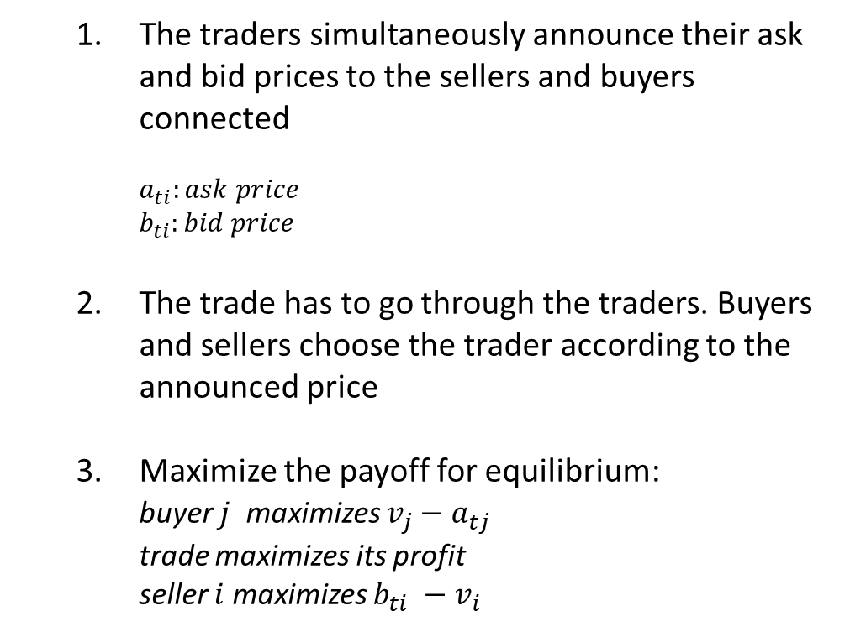


Network structure with multiple traders: simple model
  With multiple buyers, sellers, and intermediaries connected in a network structure, what might be the trading behavior at the equilibrium??
  The traders simultaneously announce their ask and bid prices to the sellers and buyers connected
    $$a_{ti}:ask price$$
    $$b_{ti}:bid price$$
  The trade has to go through the traders. Buyers and sellers choose the trader according to the announced price
  Maximize the payoff for equilibrium:
  buyer $j$ maximizes $v_{j}−a_{tj}$
  trade maximizes its profit
  seller $i$ maximizes $b_{ti} −v_{i}$
$$a_{ti}$$
$$b_{ti}$$

Slide 14
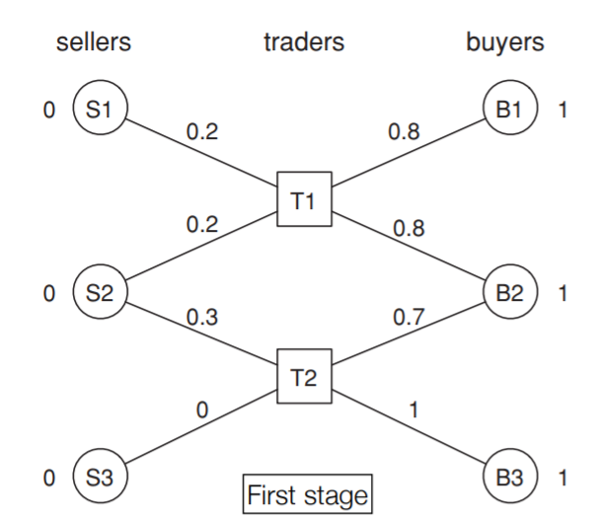
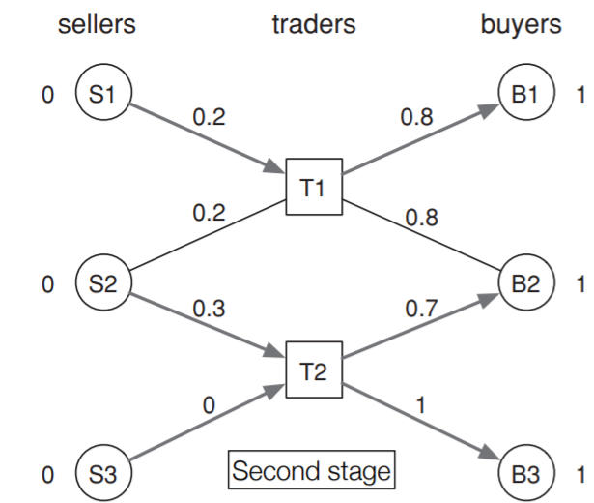
Network structure with multiple traders: simple model

Slide 15
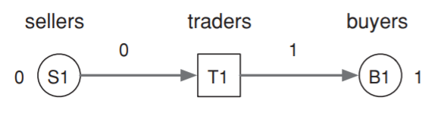
Finding bid and ask prices at equilibrium
  Best responses and Equilibrium
Monopoly
Trader can adjust the bid and ask price for the higher profit or according to his taste

Slide 16
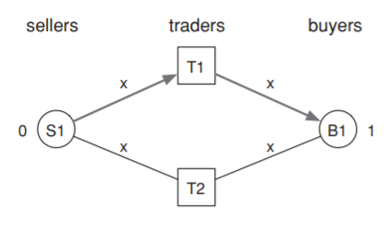
Finding bid and ask prices at equilibrium
  Best responses and Equilibrium
Perfect Competition
If T1 offers a bid at price b and ask at price a, (a>b)
T2 will offer a bid at price b and ask at lower price of a’ (a>a’>b)
Eventually, a’ continuously reduce to the level of b.
At the equilibrium, all bid and ask prices will be the same price.
At equilibrium every bid and ask will be x
(0< x <1)

Slide 17
Finding bid and ask prices at equilibrium
  The Example Network at is equilibrium
0
1
S1 -> T1 -> B1 : monopoly
x
x
S2 -> T1 -> B2
S2 -> T2- > B2
: perfect competition
x
x
S3 -> T2 -> B3 : monopoly
0
1

Slide 18
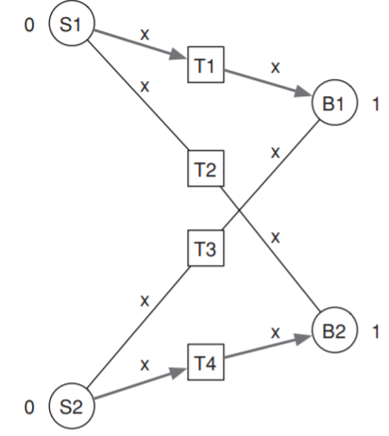
Finding bid and ask prices at equilibrium
  Implicit Perfect Competition
Although there are not any direct competition, at equilibrium all bid and ask prices will be the same

Slide 19
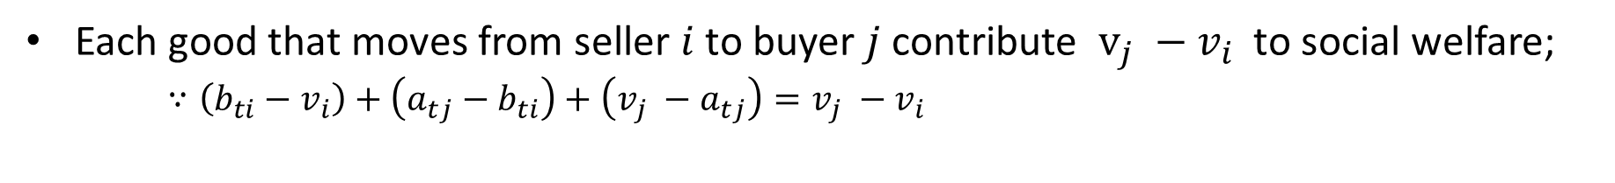
Social Welfare in trading networks
Are the solution at equilibrium socially optimal?
(Maximizing the sum of payoffs of all the players)
Each good that moves from seller $i$ to buyer $j$ contribute $v_{j} −v_{i}$ to social welfare;
$∵\left(b_{ti}−v_{i}\right)+\left(a_{tj}−b_{ti}\right)+\left(v_{j} −a_{tj}\right)=v_{j} −v_{i}$
Therefore, more richly connected networks can potentially allow a flow of goods achieving a higher social welfare

Slide 20
Social Welfare in trading networks
In every trader network, there is always a certain type of equilibrium at a specific price, producing an allocation that maximize social welfare

Slide 21
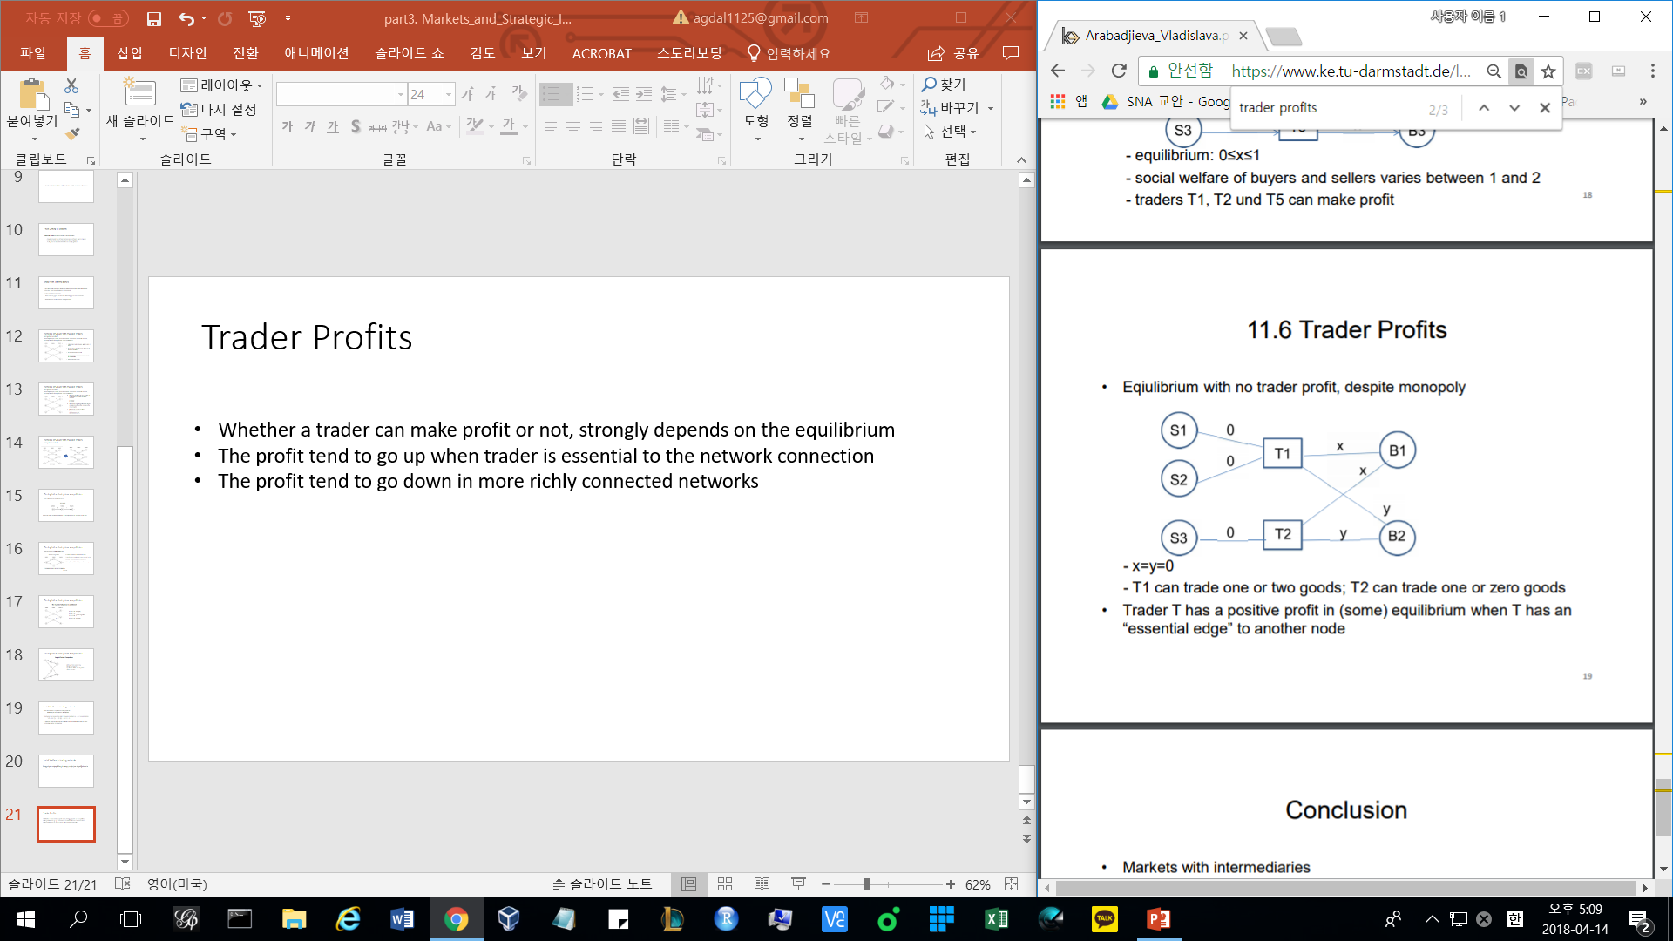
Trader Profits
Whether a trader can make profit or not, strongly depends on the equilibrium
The profit tend to go up when trader is essential to the network connection
The profit tend to go down in more richly connected networks
At all equilibrium, x = y = 0
Trades cannot make any profit
equilibrium

